Slide 1

UNIVERSITY INSTITUTE OF TECHNOLOGY, RAJIV GANDHI PROUDYOGIKI VISHWAVIDHYALAYA BHOPAL (M.P)
MAJOR PROJECT
BLOOD DONATION
Guided By:
Mr. Atul Pandey
Assistant Professor
Department of Computer Application
Presented By:
Nisha Uikey
0101CA201020
MCA 4th SEM

Slide 2
INTRODUCTION

Slide 3
Agenda
Introduction
Purpose
Overview of the Project
Software and Hardware
Tools and Technologies
Block Diagram
Work Flow

Slide 4
Introduction
The BLOOD DONATION WEBSITE is great project. This project is designed for successful completion of project on blood donation the basic building aim is to provide blood donation service to the city. This website is designed to store, process, retrieve and analyze information concerned with the administrative and inventory management within a blood bank. This project aims at maintaining all the information pertaining to blood donors, different blood groups available and help them manage in a better way.

Slide 5
Purpose
BLOOD DONATION is a website based on PHP. The purpose of this project was to develop a blood management information system to simplify and automate the process of searching for blood in case of emergency and maintain the records of blood donors, blood receiver, blood donation camps and blood stocks in the bank. And case of control the distribution of blood in various part of citys basing on the hospitals demand .

Slide 6
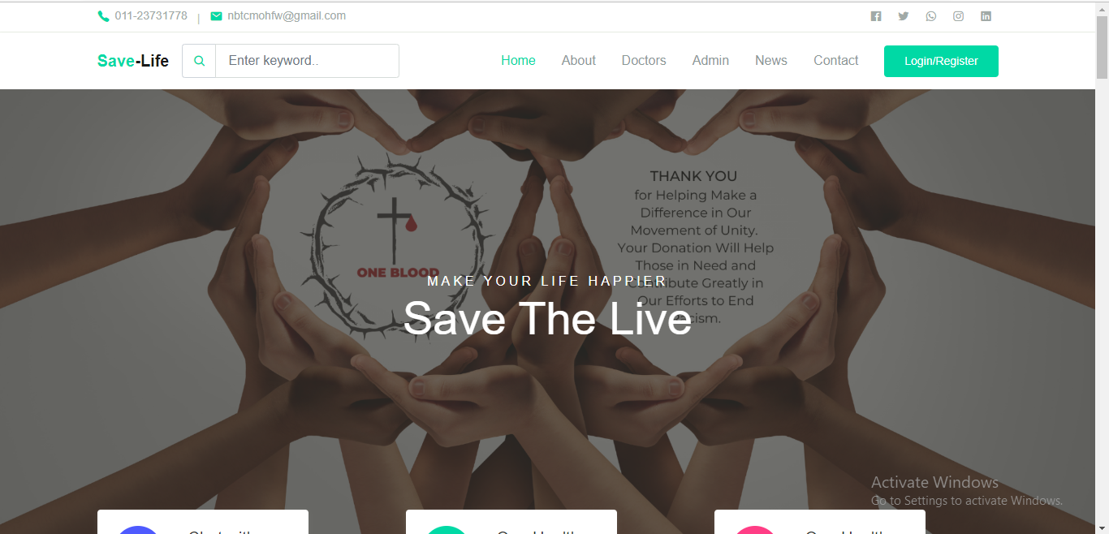
Home Page

Slide 7
Features
Doctor’s List
Blogs
Login Panel

Slide 8
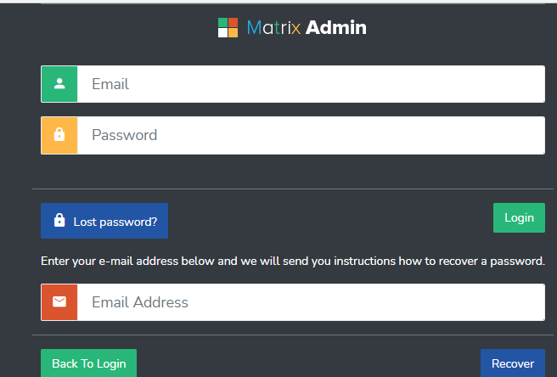
1.1 Admin
Login page
The page require user name and password to start the application Login is a process by which individual access to a computer system is controlled by identifying and authenticating the user through the cardinalities presented by the user. Admin can add update or delete.

Slide 9
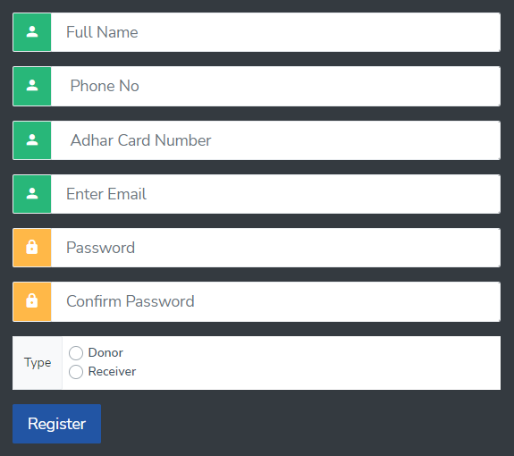
1.2 User registration
Registration page includes the information of the donor who want to register. Donor can register the account by clicking on new register. He/she can add the account for the further enquiry of the blood donation.

Slide 10

User log in
User can register the account by fill the information about you and click on Register button. He/she can add the account for the further enquiry of the blood donation. The user have to login to get more information about the blood donation.

Slide 11
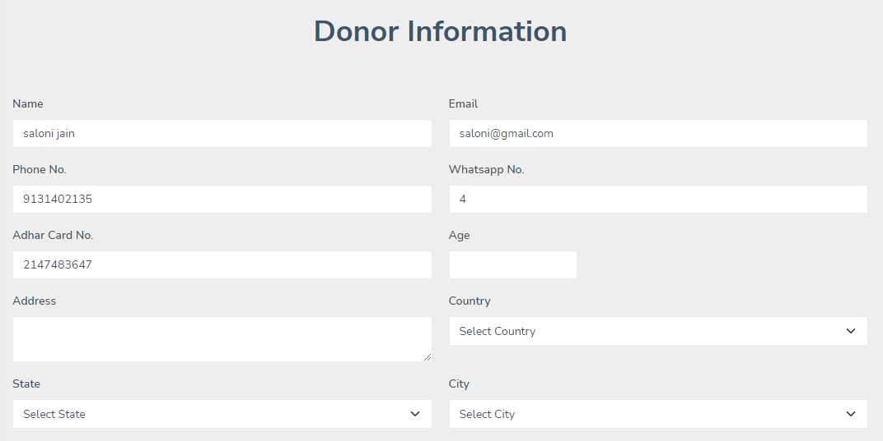
Donor Information

Slide 12
BLOCK DIAGRAM
USER
DONOR
ADMIN
DATABASE
ACCESS
DONATION
NGO
ALERT
SMS
EMAIL

Slide 13
Software and Hardware component
Software
Hardware
Xampp server
Mysql
Visual Studio
CPU Configuration- I3
RAM – 4GB
Hard-disk – 128GB
Operating System- Windows 10

Slide 14
Tools and Technologies
Front-end
Back-end
PHP
MySql
HTML
CSS
Bootstrap

Slide 15
Data flow-diagram

Slide 16
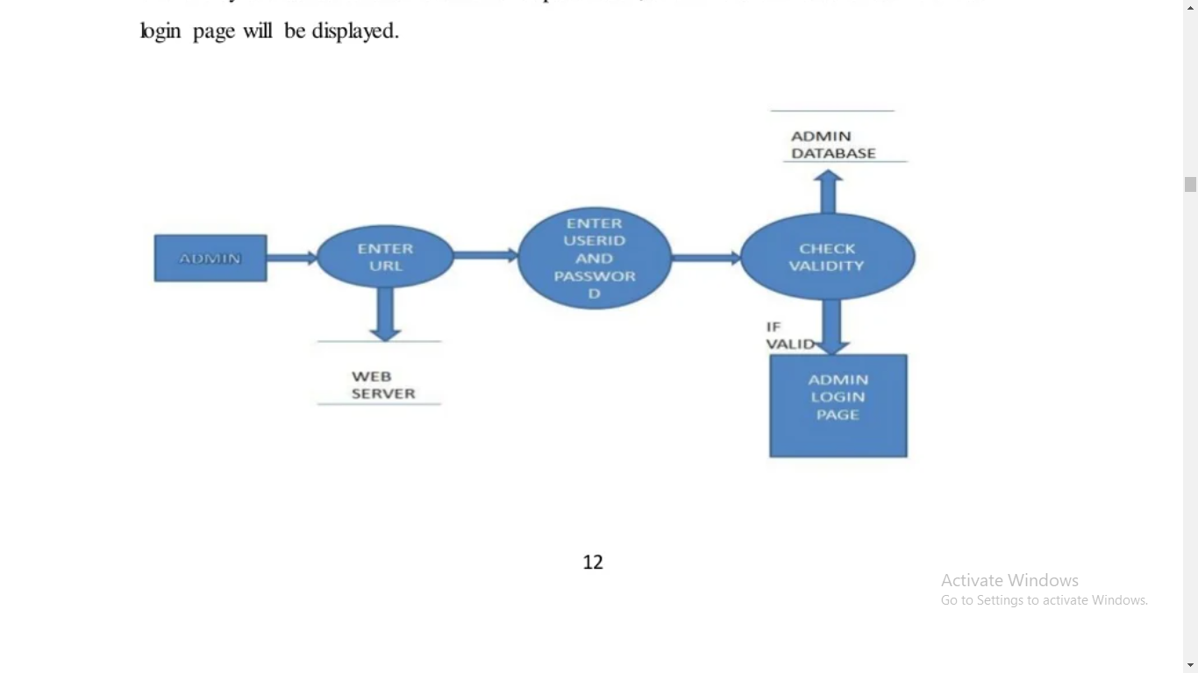
DFD for admin login
After entering to the home page of the website, admin can choose the ADMIN LOGIN option where they are asked to enter username & password, and if he/she is a valid user then admin. login page will be displayed.

Slide 17
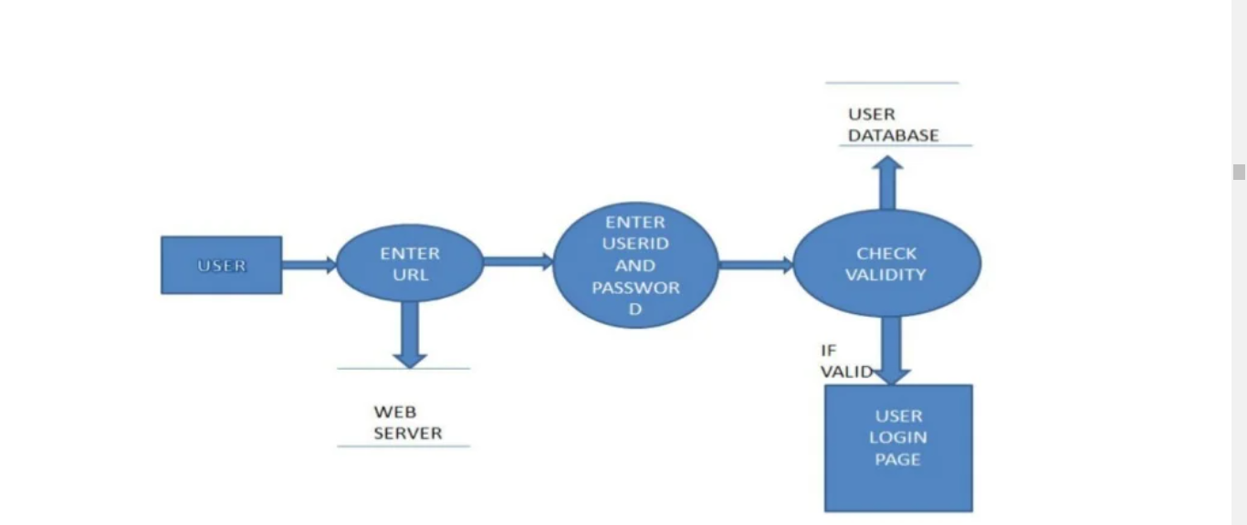
DFD for user login
After entering to the home page of the website, student can choose the USER LOGIN option where they are asked to enter username & password, and if he/she is a valid user then a user bgin page will be displayed.

Slide 18
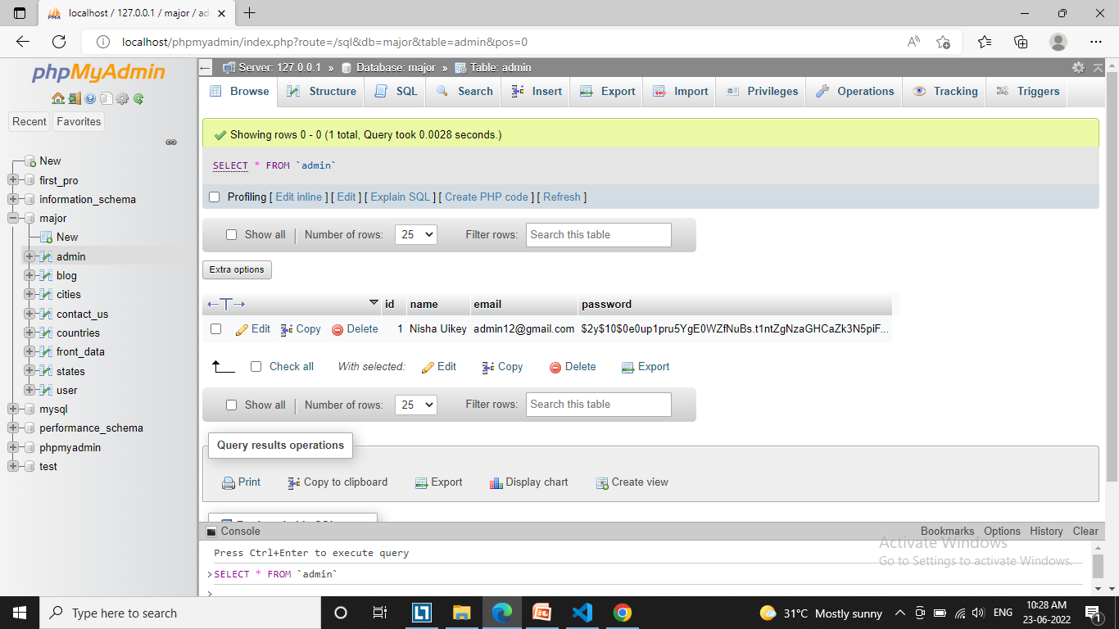
DATA BASE TABLES
ADMIN LOG IN

Slide 19
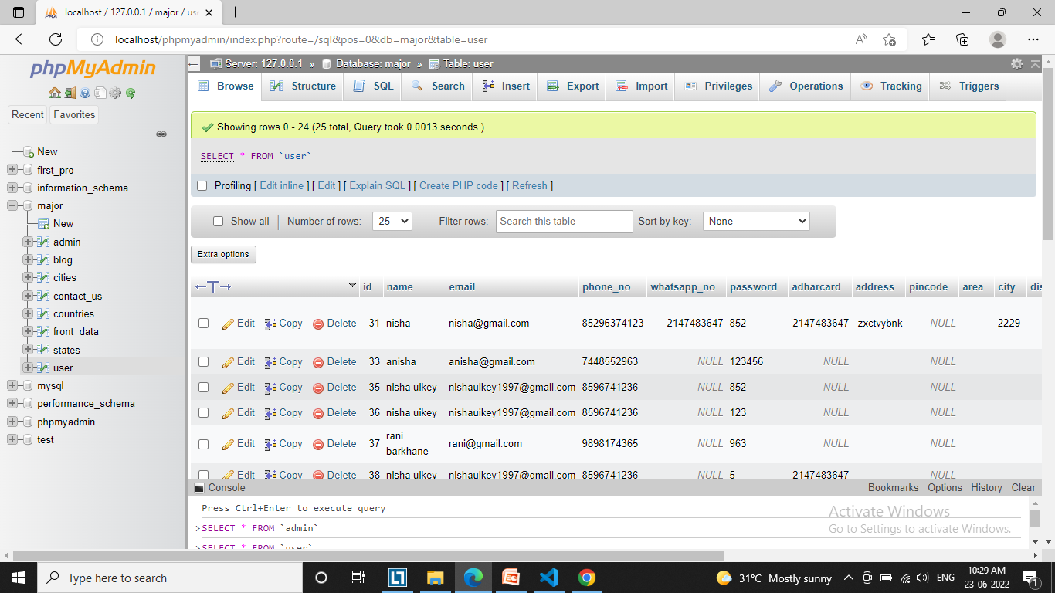
User data

Slide 20
THANK YOU

